Slide 1

How do Organisms
Reproduce?
Sexual Reproduction in flowering plants ( Structure of a stamen, carpel, types of flowers )

Slide 2
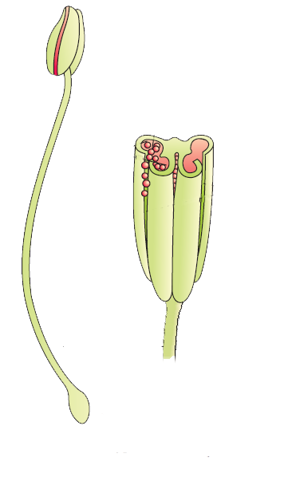
Sexual Reproduction in flowering plants
The anther is
The anther produces Pollen Grains
Every pollen grains have
Bilobed
2 male Gametes

Slide 3

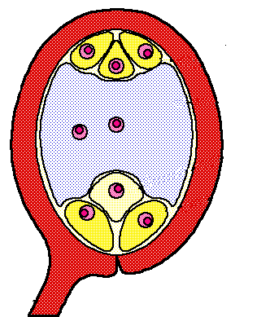
Sexual Reproduction in flowering plants
OVULE
Inside the ovule there is
EMBRYO SAC
In the center of embryo sac there is
Inside the ovary
SECONDARY NUCLEUS
At the bottom of embryo sac there is
EGG CELL
(FEMALE GAMETE)

Slide 4

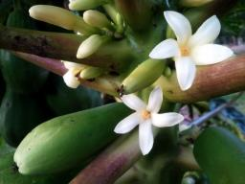
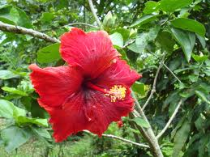
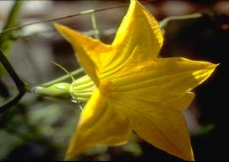
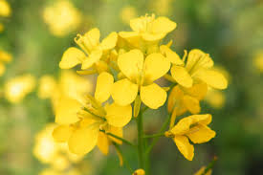
Sexual Reproduction in flowering plants
Flowers
Unisexual
Bisexual
The flower contains either stamens or carpels.
Eg- papaya, watermelon
The flower contains both stamens and carpels.
Eg-Hibiscus, mustard.

Slide 5
Thank You

